Slide 1
Lecture 5 Inferring transmission dynamics from seroprevalence data
May 23rd, 2025
Megan O’Driscoll
Seroanalytics Training Blantyre, Malawi

Slide 2
Lecture Outline
Understanding what age-specific patterns of seroprevalence can tell us about past transmission
Non-endemic transmission
Timing and magnitude of past outbreaks
Endemic transmission
Force of infection

Slide 3
Population transmission dynamics
What are the dynamics of pathogen spread in a given population?

Slide 4
Population transmission dynamics
What are the dynamics of pathogen spread in a given population?
Endemic
Sustained/persistent transmission
Can have epidemic or seasonal cycles
Non-Endemic
Sporadic outbreaks
Transmission is not continuous
Adding figures here for examples

Slide 5
Why is this useful?
Many infections can be missed by disease surveillance systems
Asymptomatic and mild infections
To understand when in the past these infections occurred
Quantifying annual risks of infection or average outbreak size
Valuable for planning control & prevention efforts

Slide 6
Age = time spent at risk of infection
As we get older, we are more likely to have encountered more pathogens
Age = time spent at risk of infection
Age is therefore a proxy for time
Age-specific seroprevalence can therefore help tell us what has happened in the past

Slide 7
When is this applicable?
When seroprevalence ≈ ever infected
Pathogen:
Must be a pathogen that induces long-term antibody response
Antibody isotype:
IgG (longest-lived isotype)
Study type:
Cross-sectional seroprevalence studies
One time-point, single sample per person
Sometimes, data from cohort or other studies can be used
E.g. the first sample from each participant (if taken around the same timeframe)

Slide 8



Example
<5 years
≥5 years
Seroprevalence=0%
Seroprevalence=30%

Slide 9
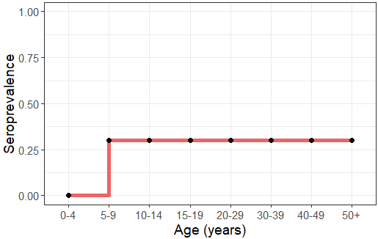
Example
<5 years old
≥ 5 years old
Seroprevalence=0%
Seroprevalence=30%
What kind of transmission has happened here?

Slide 10
Example
Non-endemic transmission
0% seroprevalence in children aged 0-4 means the pathogen has not transmitted in the past 4 years
An equal infection attack rate among those ≥ 5 years suggests:
An outbreak occurred ~ 5 years ago
30% infection attack rate

Slide 11
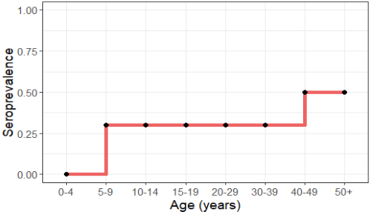
Non-endemic transmission
Flat age-specific seroprevalence profiles
Everyone alive during an epidemic has approximately the same infection risk
The more epidemics an age-group has lived through, the higher the chance of infection

Slide 12
Non-endemic transmission
Pathogen has been absent for past 4 years (0% seroprevalence in children <5)
Participants aged 5-39 have equal attack rates
-> outbreak occurred ~ 5 years ago
-> 30% attack rate
Participants aged ≥ 40 have equal attack rates
-> outbreak occurred ~40 years ago
-> 20% attack rate
These participants were alive for 2 outbreaks (20% + 30% attack rates = 50% seroprevalence)

Slide 13
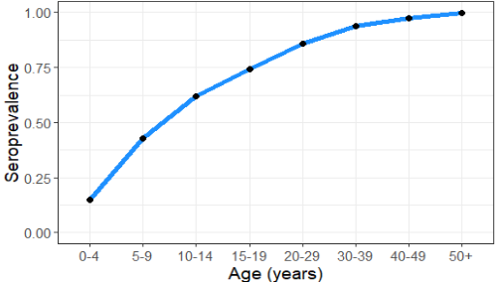
Endemic transmission
Increasing seroprevalence with increasing age
When a pathogen continuously transmits in a population, age is a direct measure of the time spent at risk of infection
Valuable to quantify the force of infection (FOI)

Slide 14
Endemic transmission: FOI
Force of infection (FOI) is also often called transmission intensity
Defined as: “Rate at which susceptible individuals become infected”
Can be estimated using a catalytic model
Fit to age-specific seroprevalence data

Slide 15
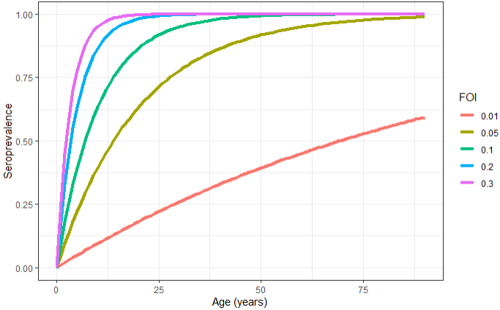
Catalytic model
ϖ_a = 1-exp(-λ*a)
λ = FOI
ϖ_a = proportion positive at age a
Assumptions:
Transmission is constant over time
Infection risk is independent of age
We will implement this using a simple regression model
glm function
complementary log-log link

Slide 16
Conclusions
Age-specific seroprevalence data can help us reconstruct past transmission dynamics
Seroprevalence that continuously increases with age indicates endemicity
Staggered, step-wise increases in seroprevalence indicate sporadic epidemics
Understanding if a pathogen is endemic or not has important public health implications
Past infection rates can be quantified
Non-endemic settings: frequency & magnitude of outbreaks
Endemic settings: force of infection

